Slide 1
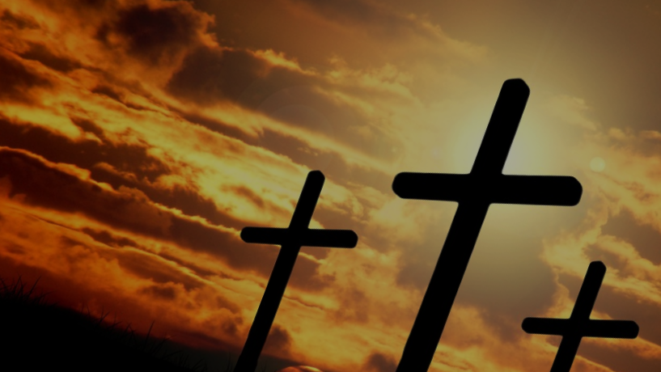
Worthy is the Lamb
“And I heard the voice of many angels around the throne, the living creatures, and the elders; and the number of them was ten thousand times ten thousand, and thousands of thousands”
Revelation 5:11
Notes:
Revelation, chapters 4 and 5 contain a word picture. A scene described by Paul that gives us a glimpse behind the curtain into the throne room of God.
The description shows that place where God dwells to be the center of all that exists.
In the scene you have the 24 elders and the 4 living creatures, together with all creation, giving praise to both the Father and the Son
Why is the Son (the Lamb of God) worthy of our praise?
(Revelation 5:9-14), “And they sang a new song, saying: “You are worthy to take the scroll, and to open its seals; for You were slain, and have redeemed us to God by Your blood out of every tribe and tongue and people and nation, ¹⁰ and have made us kings and priests to our God; and we shall reign on the earth.” ¹¹ Then I looked, and I heard the voice of many angels around the throne, the living creatures, and the elders; and the number of them was ten thousand times ten thousand, and thousands of thousands, ¹² saying with a loud voice: “Worthy is the Lamb who was slain to receive power and riches and wisdom, and strength and honor and glory and blessing!” ¹³ And every creature which is in heaven and on the earth and under the earth and such as are in the sea, and all that are in them, I heard saying: “Blessing and honor and glory and power be to Him who sits on the throne, and to the Lamb, forever and ever!” ¹⁴ Then the four living creatures said, “Amen!” And the twenty-four elders fell down and worshiped Him who lives forever and ever.”

Slide 2
Why the Lamb is Worthy of Praise
He is the appointed heir (Hebrews 1:1-4)
Notes:
He is the appointed Heir
(Hebrews 1:1-4), “God, who at various times and in various ways spoke in time past to the fathers by the prophets, ² has in these last days spoken to us by His Son, whom He has appointed heir of all things, through whom also He made the worlds; ³ who being the brightness of His glory and the express image of His person, and upholding all things by the word of His power, when He had by Himself purged our sins, sat down at the right hand of the Majesty on high, ⁴ having become so much better than the angels, as He has by inheritance obtained a more excellent name than they”
What is amazing is that we are joint-heirs with Christ
(Romans 8:16-17), “The Spirit Himself bears witness with our spirit that we are children of God, ¹⁷ and if children, then heirs—heirs of God and joint heirs with Christ, if indeed we suffer with Him, that we may also be glorified together.”
Christ, himself, is pleased to call us brethren
(Hebrews 2:11), “For both He who sanctifies and those who are being sanctified are all of one, for which reason He is not ashamed to call them brethren.”
We have a wonderful elder brother, the Lord Jesus Christ!

Slide 3
Why the Lamb is Worthy of Praise
He is the appointed heir (Hebrews 1:1-4)
He made the worlds (Colossians 1:16)
Notes:
Christ made the worlds
(Colossians 1:16), “For by Him all things were created that are in heaven and that are on earth, visible and invisible, whether thrones or dominions or principalities or powers. All things were created through Him and for Him.”
Consider the greatness of His handiwork!
We can’t measure the immensity of this universe, or see the minute details within a single atom. Yet, one hand created them all!
And, He will outlast His Creation!
(Hebrews 1:10-12), [Quoting the 102 Psalm], “You, Lord, in the beginning laid the foundation of the earth, and the heavens are the work of Your hands. ¹¹ They will perish, but You remain; and they will all grow old like a garment; ¹² like a cloak You will fold them up, and they will be changed. But You are the same, and Your years will not fail.”

Slide 4
Why the Lamb is Worthy of Praise
He is the appointed heir (Hebrews 1:1-4)
He made the worlds (Colossians 1:16)
He sustains the world by His word (Colossians 1:17)
Notes:
Christ sustains the world by His word
(Colossians 1:17), “And He is before all things, and in Him all things consist.”
All things consist or are held together through His word!
His word preserves it until the coming of His great and terrible day!
(2 Peter 3:7), “But the heavens and the earth which are now preserved by the same word, are reserved for fire until the day of judgment and perdition of ungodly men.”

Slide 5
Why the Lamb is Worthy of Praise
He is the appointed heir (Hebrews 1:1-4)
He made the worlds (Colossians 1:16)
He sustains the world by His word (Colossians 1:17)
He perfectly reflects God’s glory (John 1:18)
Notes:
Christ perfectly reflects the glory of God
(John 1:18), “No one has seen God at any time. The only begotten Son, who is in the bosom of the Father, He has declared Him.”
Jesus has shown us the Father
His glory is the glory of God
(John 1:14), “And the Word became flesh and dwelt among us, and we beheld His glory, the glory as of the only begotten of the Father, full of grace and truth.”
His is the fullness of the Godhead, in the form of a body!
(Colossians 2:9), “For in Him dwells all the fullness of the Godhead bodily”

Slide 6
Why the Lamb is Worthy of Praise
He is the appointed heir (Hebrews 1:1-4)
He made the worlds (Colossians 1:16)
He sustains the world by His word (Colossians 1:17)
He perfectly reflects God’s glory (John 1:18)
He is the expressed image of God (Colossians 1:15)
Notes:
Christ is the expressed image of God’s being
(Colossians 1:15), “He is the image of the invisible God, the firstborn over all creation.”
Being God, He shared with the Father the form of God
(Philippians 2:5-7), “Let this mind be in you which was also in Christ Jesus, ⁶ who, being in the form of God, did not consider it robbery to be equal with God, ⁷ but made Himself of no reputation, taking the form of a bondservant, and coming in the likeness of men.”

Slide 7
Why the Lamb is Worthy of Praise
He is the appointed heir (Hebrews 1:1-4)
He made the worlds (Colossians 1:16)
He sustains the world by His word (Colossians 1:17)
He perfectly reflects God’s glory (John 1:18)
He is the expressed image of God (Colossians 1:15)
He purged our sins (Hebrews 9:14)
Notes:
Christ purged our sins
He cleansed us with his own blood
(Hebrews 9:14), “how much more shall the blood of Christ, who through the eternal Spirit offered Himself without spot to God, cleanse your conscience from dead works to serve the living God?”
He redeemed us at a great personal cost
(Ephesians 1:7), “In Him we have redemption through His blood, the forgiveness of sins, according to the riches of His grace.”

Slide 8
Conclusion
Jesus Christ is now in heaven at His Father’s right hand. He rules with honor and glory! He is worthy of all the praise we give Him.
Daniel 7:13-14
Notes:
Jesus Christ is now in heaven at His Father’s right hand.
He rules with honor and glory!
He is worthy of all the praise we give Him.
(Daniel 7:13-14), [Daniel saw the glory of the Son of Man in a dream], “I was watching in the night visions, and behold, One like the Son of Man, coming with the clouds of heaven! He came to the Ancient of Days, and they brought Him near before Him. ¹⁴ Then to Him was given dominion and glory and a kingdom, that all peoples, nations, and languages should serve Him. His dominion is an everlasting dominion, which shall not pass away, and His kingdom the one which shall not be destroyed.”
Will you not give him your praise, your respect and honor?
Will you not give him yourself as a living sacrifice by bending your will to the King of Kings?

